Slide 1
PtNi3—on HP West
by Will Mann

Slide 2
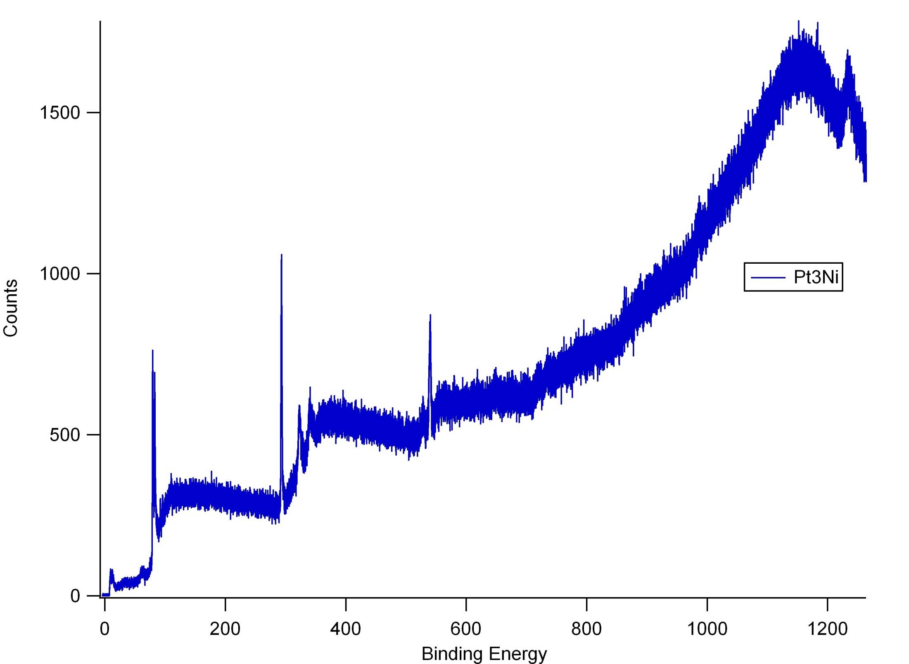
Ni 2s**
Ni 2p 1/2**
?? About 1227 eV
Ni 2p 3/2
C 1s
Pt 4p 1/2**
Pt 4d 5/2
Pt 4d 3/2
O 1s
Pt 4s**
Pt 4f 7/2
Pt 4f 5/2
Pt 4p 3/2
Pt 5s**
Ni 3s**
Pt 5p3/2
** = expected location
Au 4f 7/2,5/2
Pt 5p1/2, Ni 3p 3/2, Ni 3p 1/2**

Slide 3
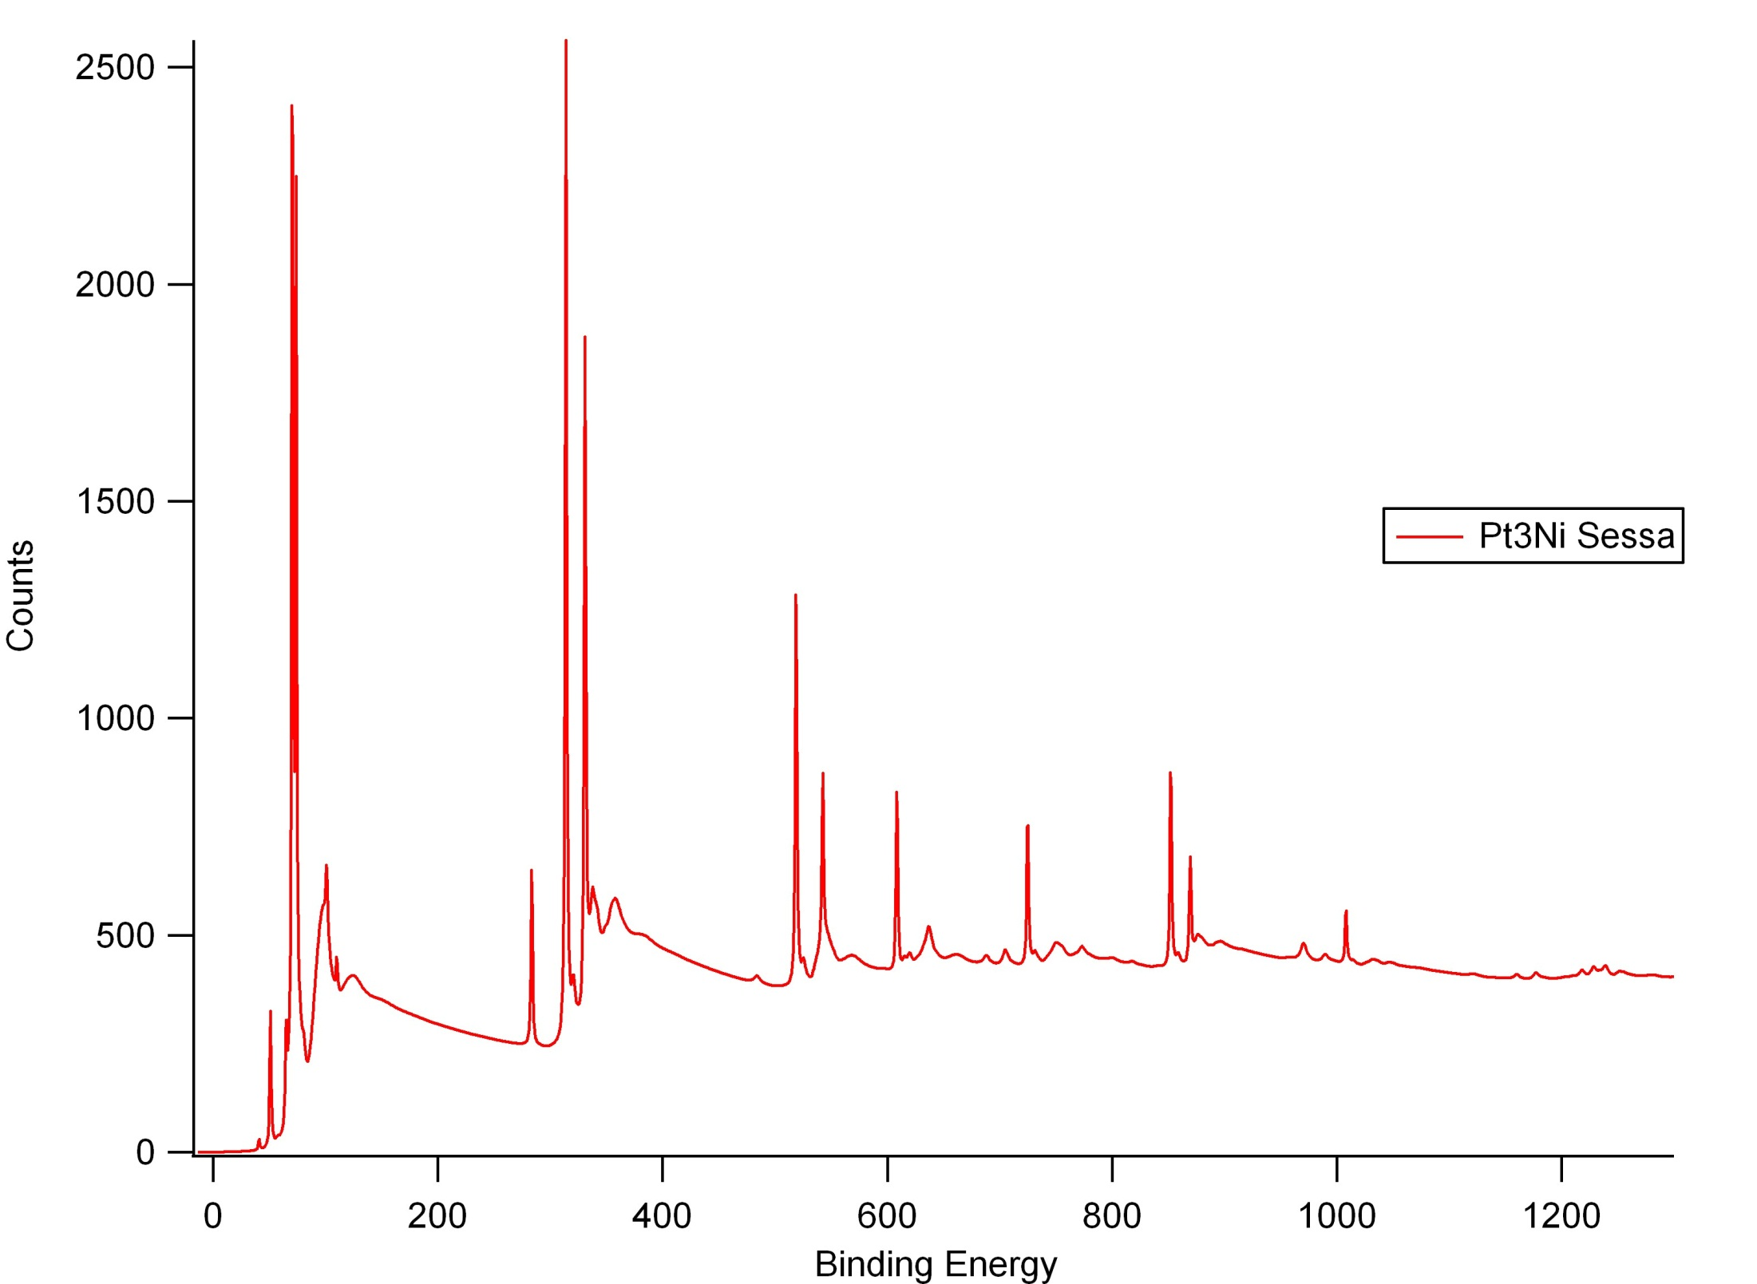
Pt 4d 5/2
Pt 4f 5/2
Pt 4f 7/2
Pt 4d 3/2
Pt 4p 3/2
Pt 4p 1/2
Ni 2p 3/2
O 1s
Pt 4s
Ni 2p 1/2
Pt 5s
C 1s
Pt 5p3/2
Ni 2s
Ni 3s
O 2s
Pt 5p1/2, Ni 3p 3/2, Ni 3p 1/2

Slide 4
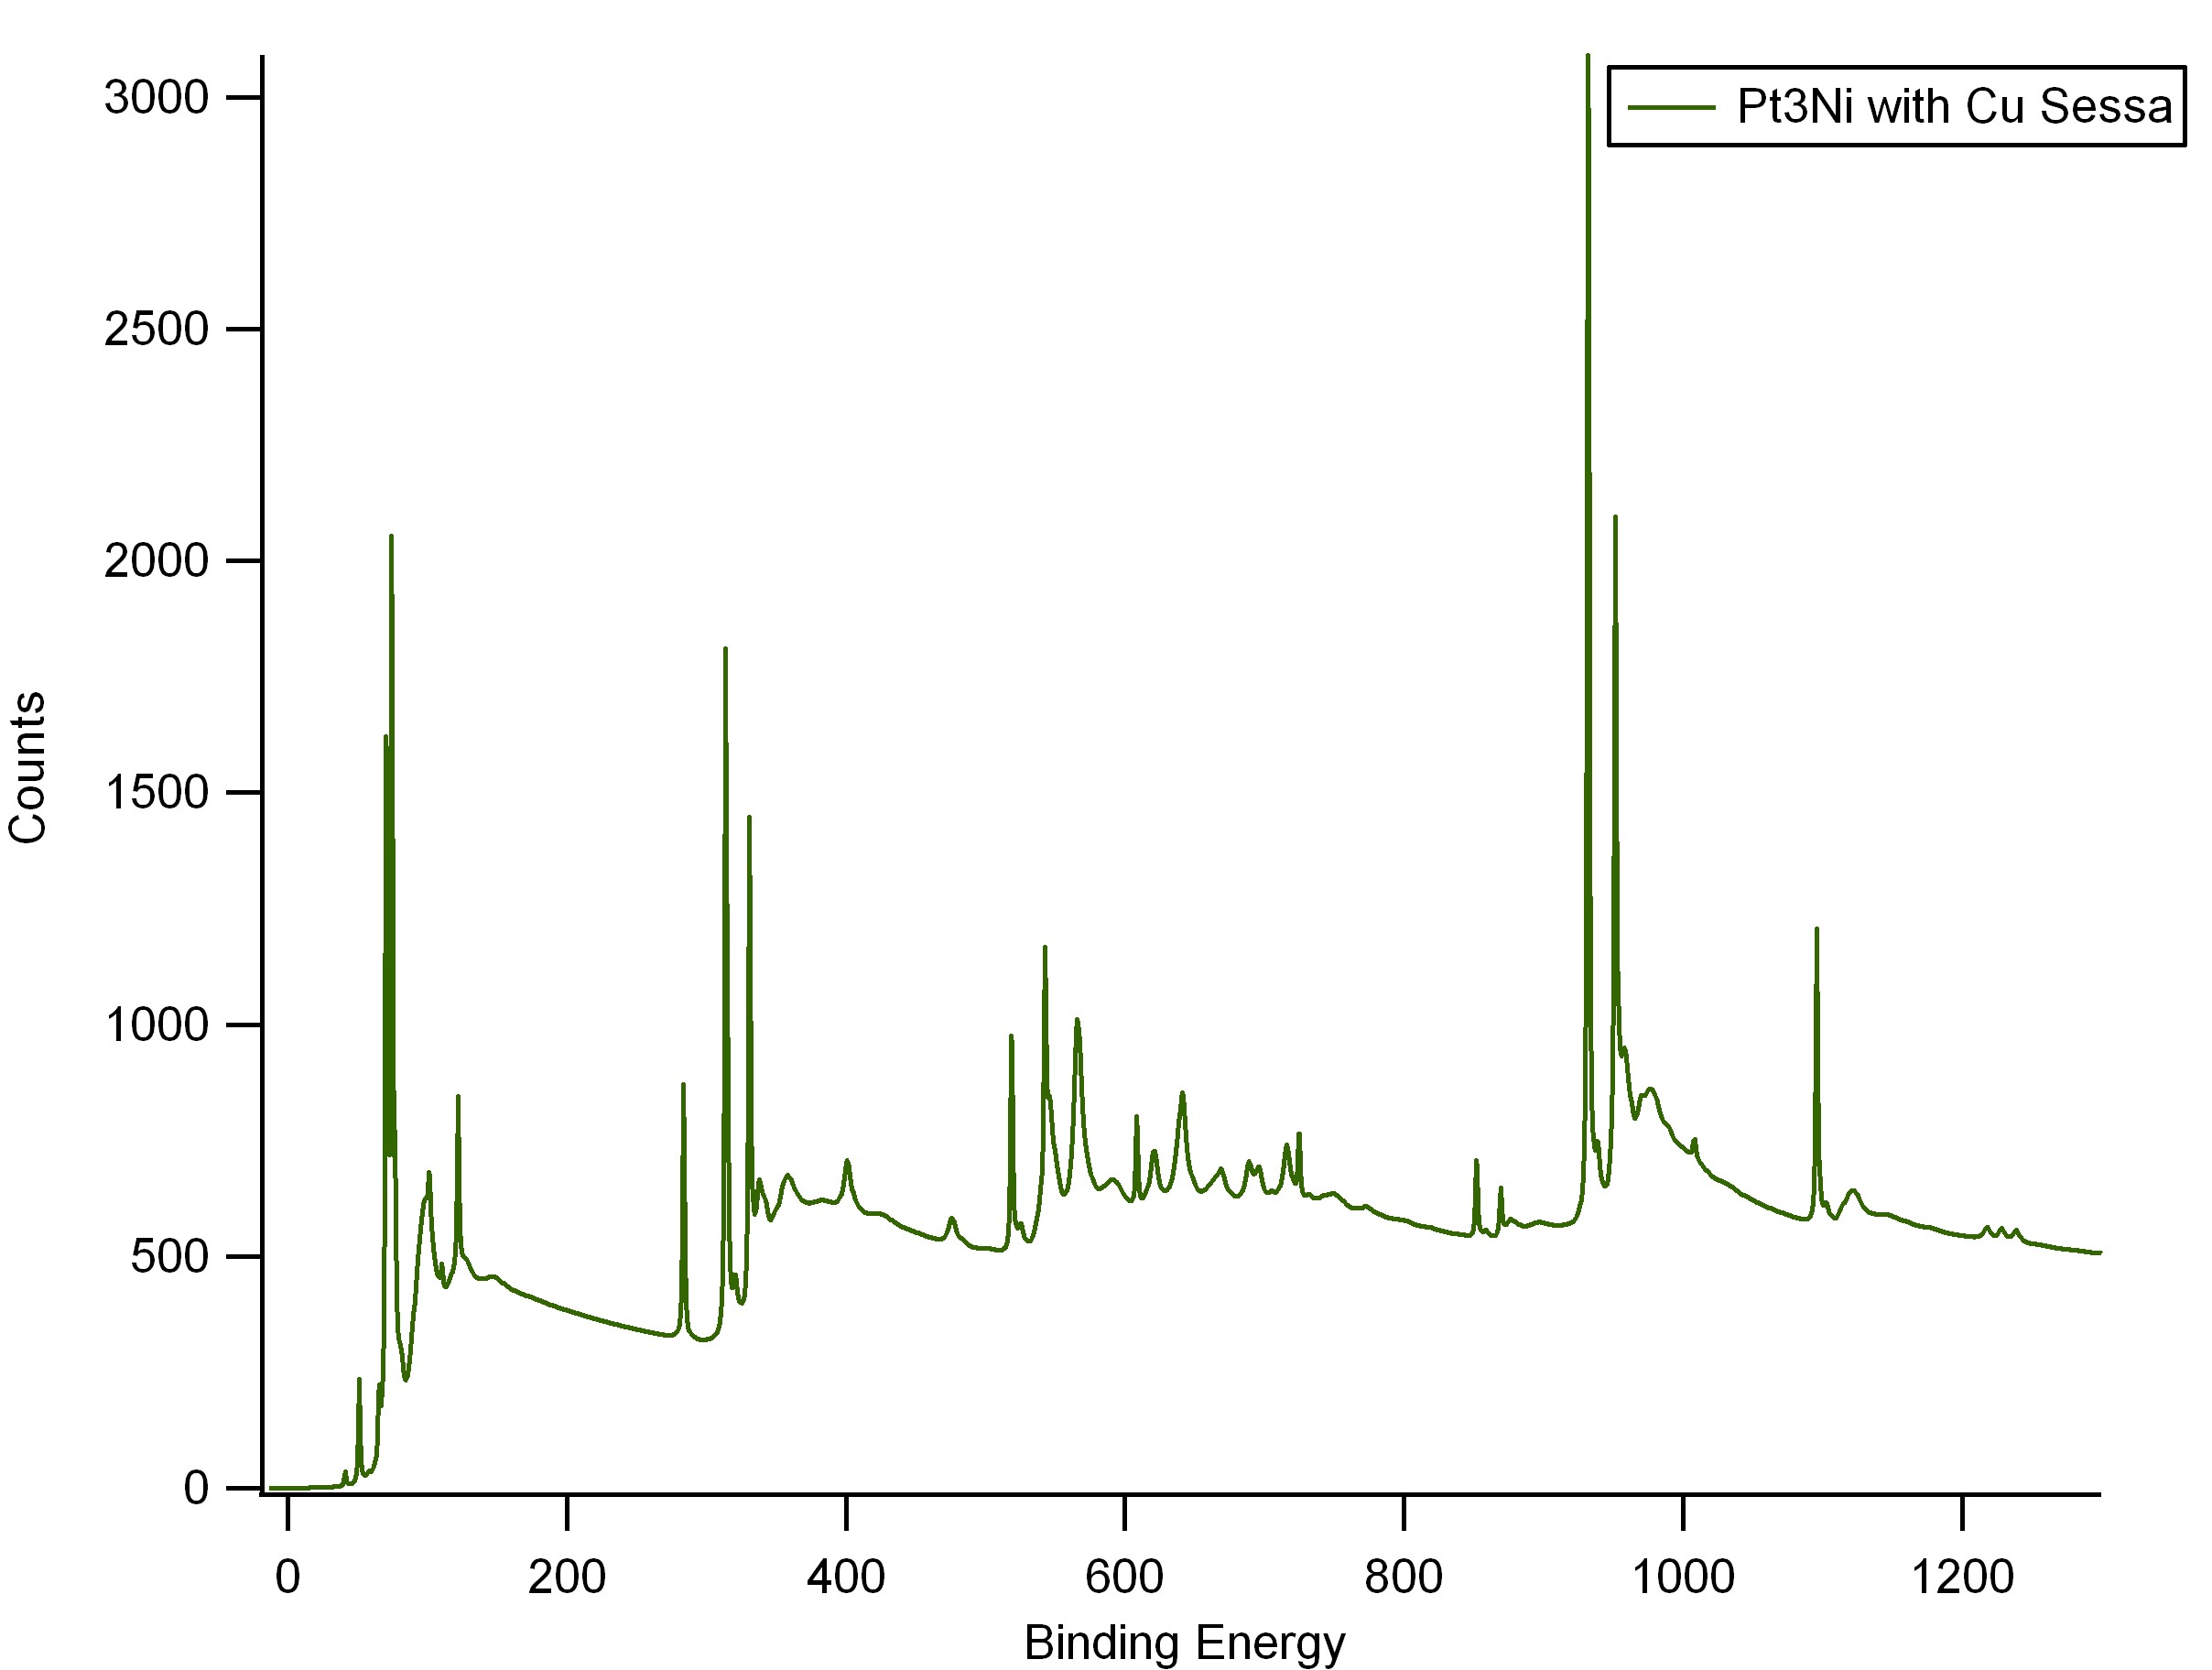
Cu 2p 3/2
Cu 2p 1/2
Cu 3p 3/2, 1/2
Cu 3s
Cu 2s

Slide 5
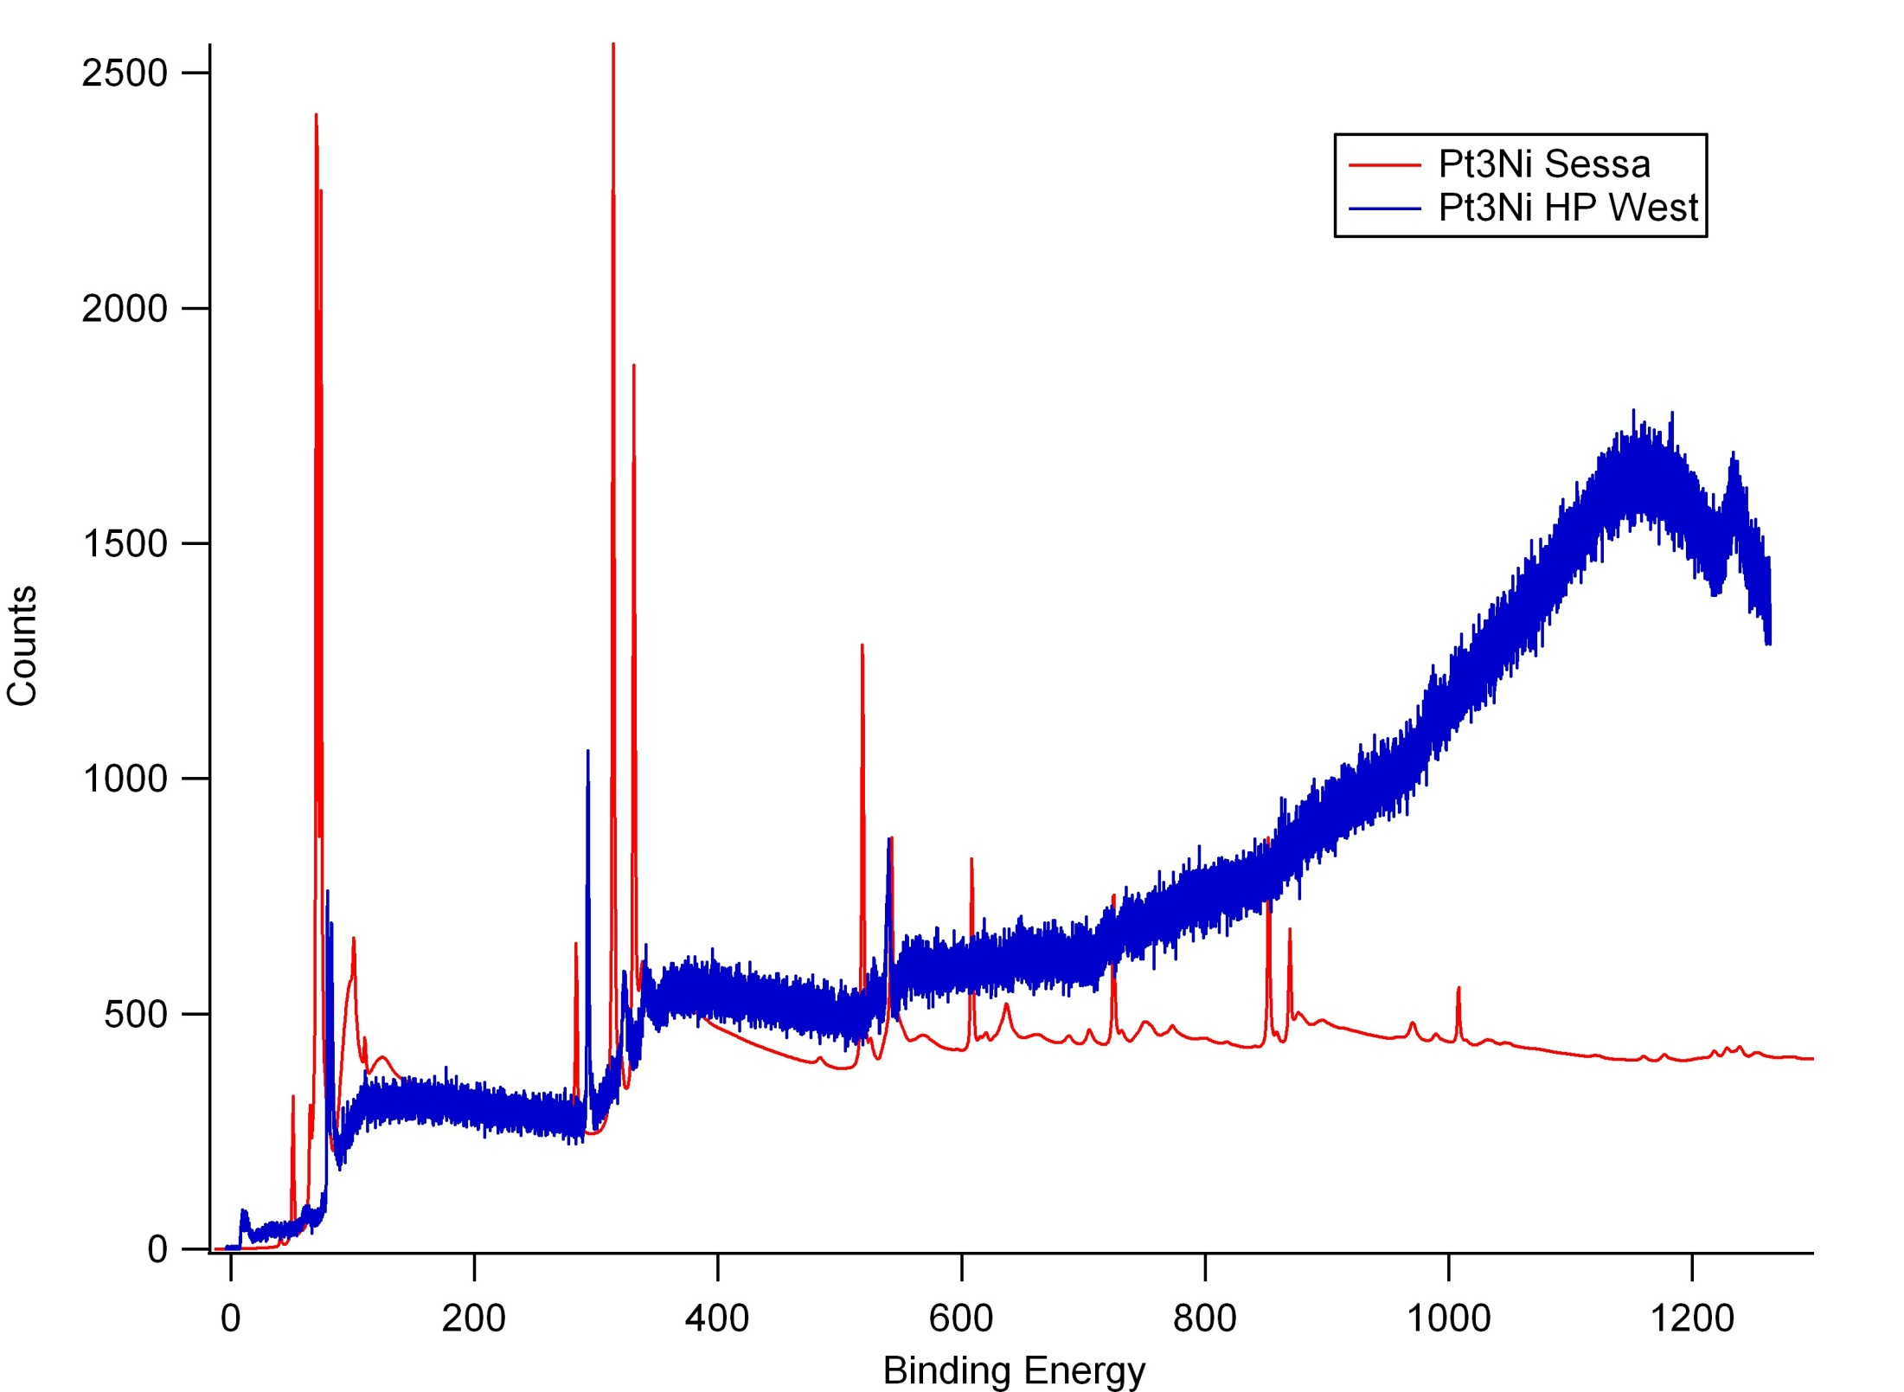

Slide 6
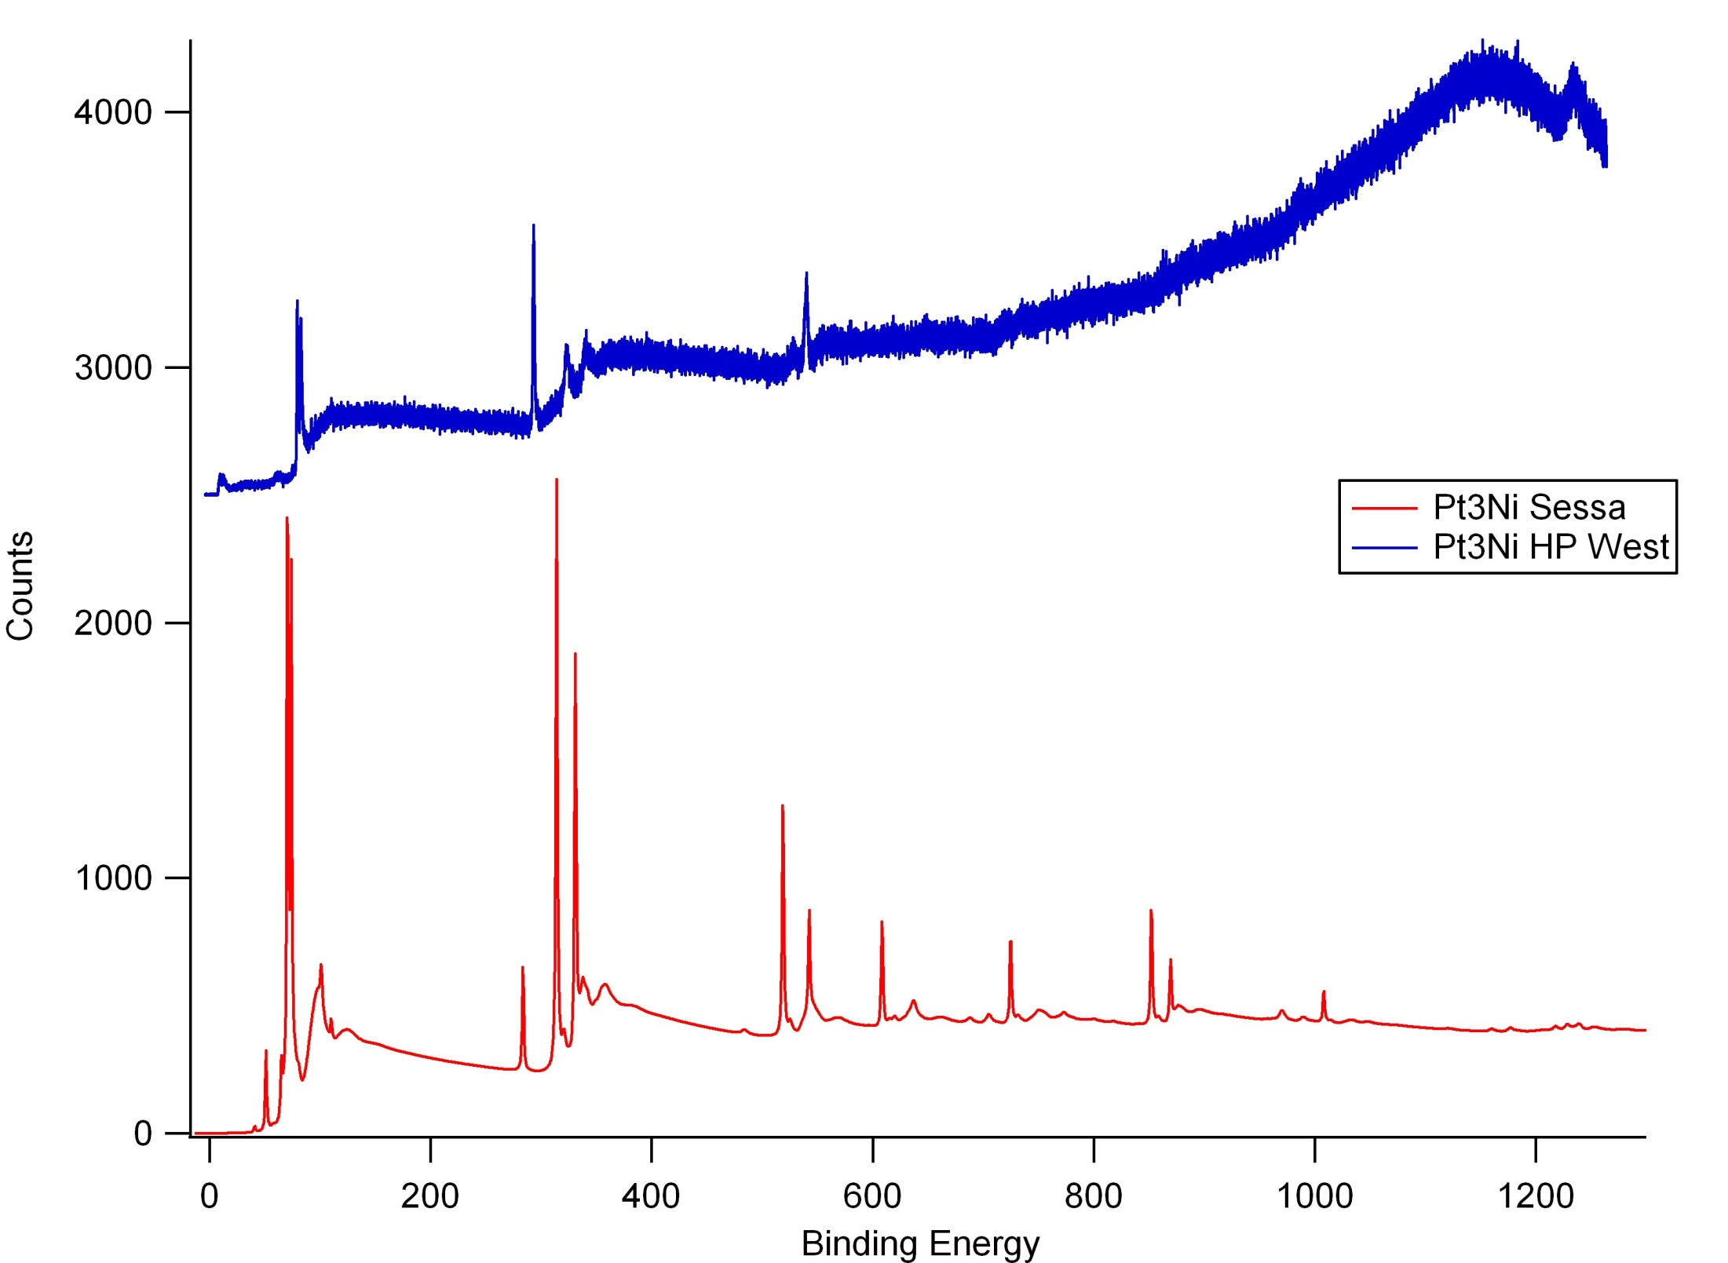

Slide 7
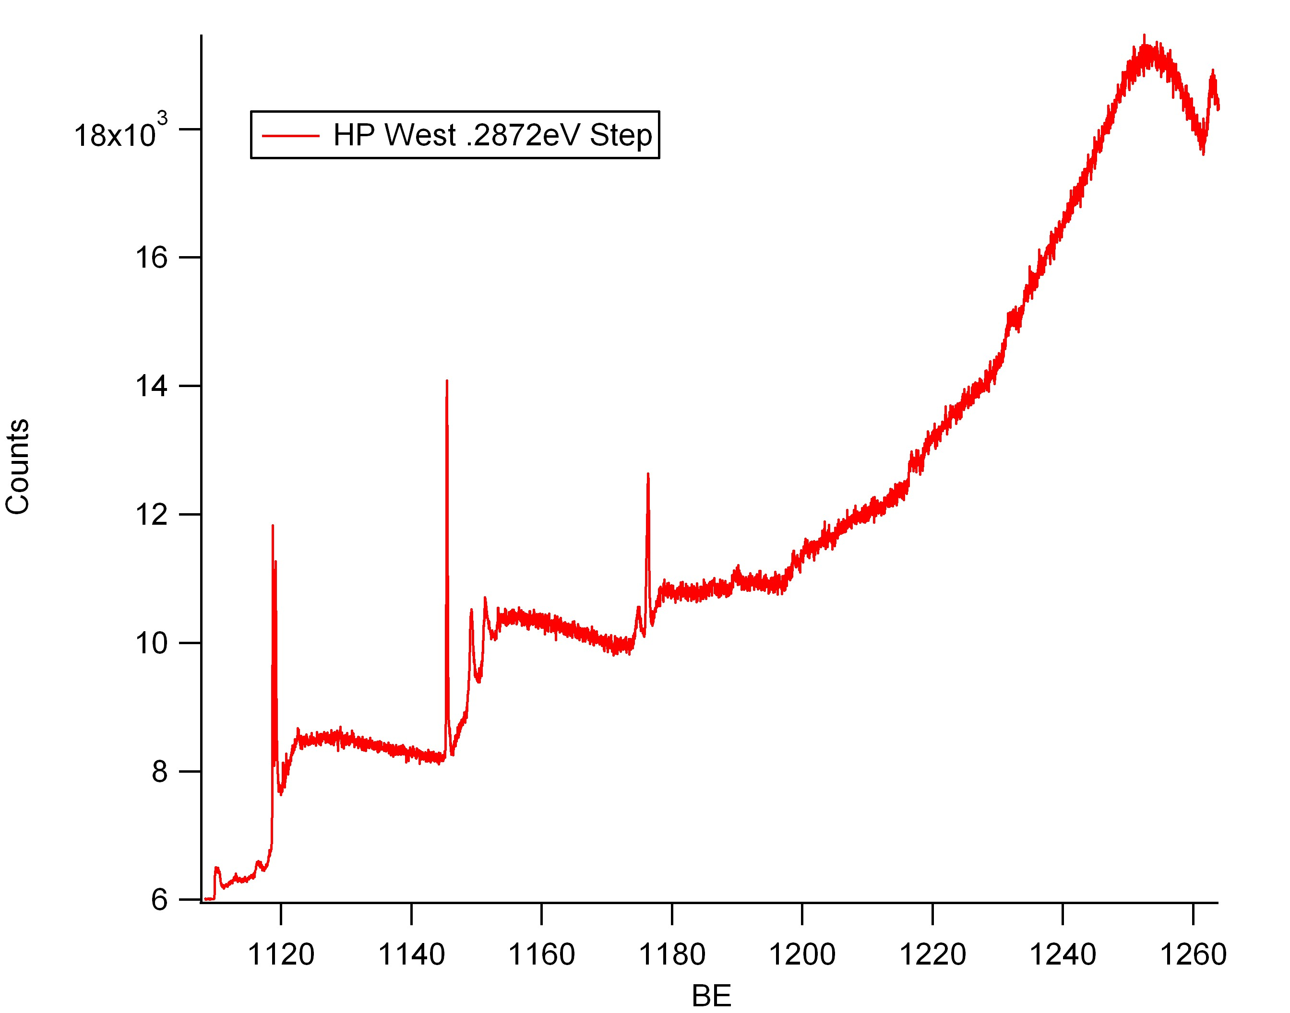
Same HP West Data from before but re-binned combining 8 bins into 1

Slide 8
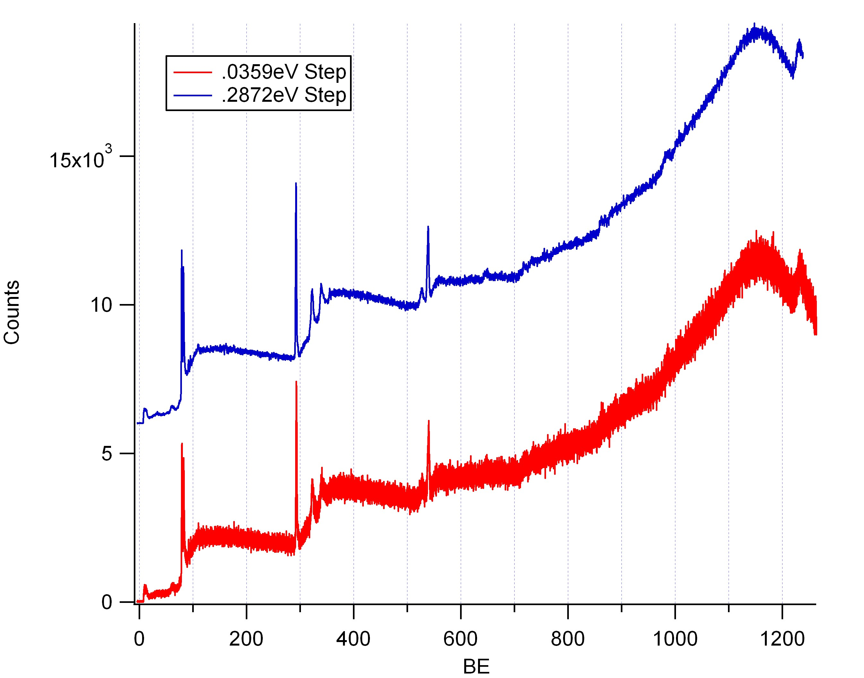

Slide 9
HP West (re-binned) vs Big Blue Data Goes Here

